Slide 1
Sevenett DABC
Introduction to Data Analytics

Slide 2
What is Data
When we talk about data analytics what comes to your mind?

Slide 3
What is Data Analytics?
Data Analytics refers to the process of examining datasets to draw conclusions about the information they contain. This process employs various tools and techniques to identify patterns, uncover trends, and extract actionable insights from raw data.
Data analytics plays a pivotal role in decision-making processes by providing evidence-based insights. These insights enable organizations to:
Optimize operations and increase efficiency.
Enhance customer understanding and service.
Make informed strategic decisions to drive growth and innovation.

Slide 4
Data Science
Data science is an interdisciplinary field that involves extracting knowledge and insights from data using various methods, tools, and algorithms. It helps in identifying patterns, trends, and relationships within data to solve complex problems and make informed decisions across various domains.

Slide 5
Key Components of Data Analytics
Data Collection: The process of gathering information from various sources, including internal databases, online transactions, and social media.
Data Processing: Transforming raw data into a more usable format through cleaning and structuring.
Data Analysis: Applying statistical analysis and algorithms to interpret and draw conclusions from processed data.
Data Visualization: Presenting data in graphical formats to easily convey insights and trends to stakeholders.
Data Interpretation: Understanding and communicating the significance of data analysis outcomes to inform decision-making.

Slide 6
Significance of Data Analytics
Influence Across Various Sectors
Healthcare
Impact: Improves patient care through predictive analytics, identifying risk factors, and personalizing treatment plans.
Example: Using data analytics to predict outbreaks, improve diagnostics, and enhance the efficiency of healthcare delivery.
Finance
Impact: Enhances risk management, detects fraud in real-time, and personalizes customer services.
Example: Financial institutions use analytics for credit scoring, market analysis, and algorithmic trading to maximize profits and reduce losses.

Slide 7
Significance of Data Analytics
Marketing
Impact: Drives targeted advertising, optimizes marketing campaigns, and improves customer relationship management.
Example: Retailers leverage customer data to tailor marketing efforts, resulting in higher conversion rates and customer retention.
Technology
Impact: Fuels innovation in product development, improves user experience, and streamlines operations.
Example: Tech companies use data analytics to forecast trends, enhance cybersecurity measures, and personalize user experiences across digital platforms.

Slide 8
Successful Companies Utilizing Data Analytics:
Amazon:
Utilizes data analytics for personalized product recommendations.
Optimizes its supply chain and logistics using predictive analytics.
Leverages customer data for targeted marketing strategies.
Netflix:
Employs data analytics to recommend content based on user preferences.
Analyzes viewing patterns to create original content that resonates with the audience.
Uses data-driven insights for content acquisition and licensing decisions.

Slide 9
Successful Companies Utilizing Data Analytics:
Uber:
Uses data analytics for dynamic pricing based on demand patterns.
Optimizes route planning and driver allocation through analytics.
Implements predictive analytics for estimating arrival times.
Procter & Gamble:
Applies data analytics for demand forecasting and inventory management.
Uses consumer data for product innovation and marketing strategies.
Optimizes pricing strategies based on market trends.

Slide 10
Real-World Cases Where Lack of Data-Driven Decisions Led to Problems:
1. Kodak:
Kodak failed to adapt to the digital photography revolution due to a lack of data-driven insights.
The company did not foresee the shift in consumer behavior and failed to capitalize on emerging technologies
2. Nokia:
Despite being a dominant player in the mobile phone market, Nokia neglected the shift towards smartphones.
Lack of data-driven decisions and market analysis resulted in a decline in market share and eventual acquisition.
2. Blackberry:
Blackberry's failure to adapt its operating system and device offerings to changing consumer preferences.
Ignored the rise of touchscreen smartphones, leading to a decline in market share.

Slide 11
Data Types
Categorical data: Non-numeric, unordered, and often represented using labels or text. Can be further classified as nominal or ordinal.
Numerical data:
Discrete data: Consists of whole numbers or integers. Often used for counting or representing quantities that cannot be divided into smaller parts.
Continuous data: Consists of real numbers and can take on an infinite number of values within a given range. Often measured using instruments or sensors with precision.
Ordinal data: Represents categories with a natural order or ranking. The order of the categories is meaningful, but the differences between the categories may not be uniform.

Slide 12
Types of Data
Structured data: Highly organized and follows a predefined format, easily stored in relational databases (e.g., customer records, financial transactions).
Unstructured data: Lacks a fixed structure and format, requiring specialized techniques for processing (e.g., text documents, images, audio, video).
Semi-structured data: Contains some internal organization but doesn't strictly adhere to a schema (e.g., XML, JSON).

Slide 13
Data Dynamics & Data Management
Data Dynamics:
Static data: Remains unchanged over time (e.g., historical sales data).
Streaming data: Continuously generated and requires real-time processing (e.g., sensor data, social media feeds).
Data Management:
Data acquisition: Collecting data from various sources (e.g., databases, sensors, web APIs).
Data storage: Choosing appropriate storage solutions based on data type and volume (e.g., relational databases, cloud storage).
Data management: Organizing, maintaining, and securing data throughout its lifecycle.

Slide 14
Data Science Tools
Programming languages: R, Python, Java, Scala, C/C++.
Statistical software: SAS, SPSS, Matlab.
Database management systems: SQL, MySQL, PostgreSQL.
Big data frameworks: Hadoop, Hive, Pig, Spark.
Data visualization tools: Tableau, Power BI, ggplot2.
Machine learning libraries: TensorFlow, PyTorch, scikit-learn.
Web development tools: HTML, CSS, JavaScript.
Data cleansing tools: OpenRefine, Trifacta Wrangler.
GIS tools: ArcMap, QGIS.

Slide 15
Applications of Data Science
Business: Market research, customer segmentation, fraud detection, risk management.
Criminal justice: Crime prediction, recidivism risk assessment, resource allocation.
Healthcare: Disease diagnosis, personalized medicine, drug discovery.
Industry: Predictive maintenance, process optimization, quality control.
Education: Personalized learning, student performance prediction, educational resource development.
Internet of Things (IoT): Sensor data analysis, smart city management, connected devices optimization.
Politics: Voter behavior analysis, campaign optimization, policy evaluation.

Slide 16
Types of Analytics
Descriptive Analytics:
Descriptive analytics focuses on summarizing historical data to understand what has happened in the past. It involves organizing, aggregating, and visualizing data to provide insights into trends, patterns, and relationships.
Example: A retail company analyzes sales data from the past year to identify trends in customer purchasing behavior. They create visualizations and reports to understand which products are selling well, peak sales periods, and customer demographics.

Slide 17
Predictive Analytics:
Predictive analytics involves using statistical and machine learning algorithms to forecast future outcomes based on historical data and trends. It leverages techniques such as regression analysis, time series forecasting, and machine learning models to predict probabilities and make informed decisions about future events or trends.
Example: An insurance company uses predictive analytics to assess the risk of policyholders filing claims in the future. By analyzing historical claims data along with demographic and lifestyle factors, the company can predict the likelihood of future claims and adjust premiums accordingly.

Slide 18
Prescriptive Analytics:
Prescriptive analytics goes beyond predicting future outcomes to recommend actions or decisions that can optimize results or achieve specific objectives. It involves analyzing data, evaluating different scenarios, and recommending the best course of action based on predefined criteria or business rules.
Example: A transportation company uses prescriptive analytics to optimize delivery routes and schedules. By analyzing factors such as traffic patterns, weather conditions, and delivery priorities, the company can recommend the most efficient routes and schedules to minimize costs and improve customer satisfaction.

Slide 19
Diagnostic Analytics
Diagnostic analytics aims to understand why certain events or outcomes occurred by identifying the root causes behind them. It involves analyzing historical data to uncover correlations and causal relationships between variables.
Example: A manufacturing company uses diagnostic analytics to identify the root causes of defects in its production process. By analyzing production data and quality control metrics, the company can pinpoint factors such as machine malfunctions, operator errors, or raw material issues that contribute to defects and take corrective actions to improve product quality.

Slide 20
Case study
Challenge: Sevenett wants to improve its decision-making processes, optimize inventory management, and enhance customer satisfaction. They realize the potential of data analysis in achieving these goals and decide to introduce data analysis techniques into their operations.
Objective: The objective of this case study is to illustrate how the introduction of data analysis can benefit Sevenett in various aspects of their business.
1) Suggest the implementation steps you would apply
2) What would be the results and benefits of implementing this project?

Slide 21
Presentation of Data
Presentation of data is crucial in analytics. Analysts will not be able to make the best out of the data if they are not presentable and appropriate. One of the most convincing and appealing ways in which statistical data can be presentable is through diagrams and graphs. A few such ways are different types of diagrams, graphs and maps.

Slide 22
Importance of data presentation
Data presentation uses visual tools like charts, graphs, and dashboards to represent complex information in a way that is easily digestible
By presenting data in a clear and concise manner, organizations can make informed decisions quickly.
Visual data presentation helps in identifying trends and patterns that might not be obvious from raw data
Engaging visuals and interactive dashboards increase stakeholder engagement with data
Data storytelling is a powerful way to communicate the implications of data analytics. Through narrative combined with visual data presentation, analysts can tell compelling stories that drive home the importance of data-driven insights, fostering a culture of informed decision-making

Slide 23
Importance of data presentation
Effective data presentation practices promote a data-driven culture within organizations by making data more accessible and understandable for everyone, regardless of their technical expertise
Data presentation condenses vast amounts of data into formats that can be quickly understood, allowing for rapid response to emerging trends and challenges.
Data presentation can be tailored to the needs and preferences of different audiences, ensuring that information is relevant and impactful.

Slide 24
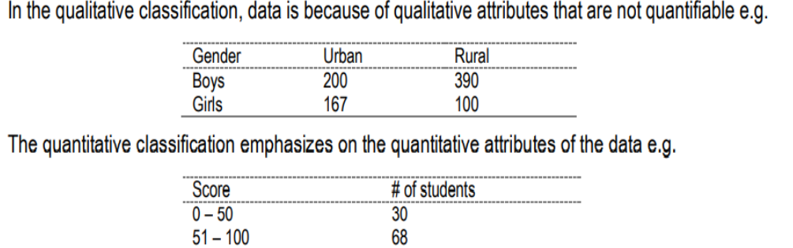
Tabular Method
It is a table that helps to represent even a large amount of data in an engaging, easy to read, and coordinated manner. The data is arranged in rows and columns. There are four most common tabular classification methods namely; qualitative classification, quantitative classification, temporal classification and the spatial classification.

Slide 25
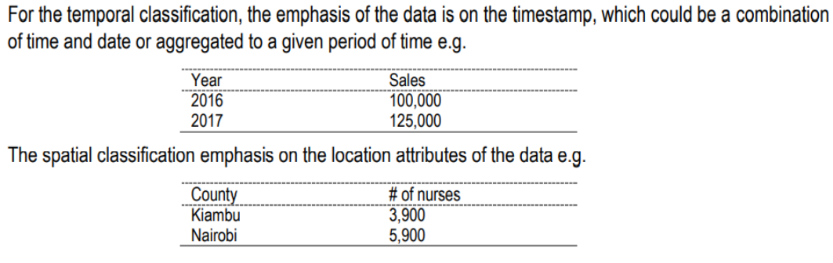
Temporal-Time and Spatial-Location

Slide 26
Dashboards
Overview: Interactive platforms that provide real-time data visualization and insights.
Application: Ideal for monitoring KPIs (Key Performance Indicators) and trends, especially in business contexts.

Slide 27
Frequency distributions
To describe situations, draw conclusions, or make inferences about events, organizing raw data must be in some meaningful way. The most convenient method of organizing data is to construct a frequency distribution.
• A frequency distribution is the organizing of raw data in table form, using classes and frequencies. There are three basic types of frequency distributions, and there are specific procedures for constructing each type. The three types are categorical, ungrouped, and grouped frequency distributions

Slide 28
Categorical Frequency Distribution
The categorical frequency distribution is for data that is in specific categories, such as nominalor ordinal level data.
For example, data such as political affiliation, religious affiliation, or major field of study would use categorical frequency distributions

Slide 29
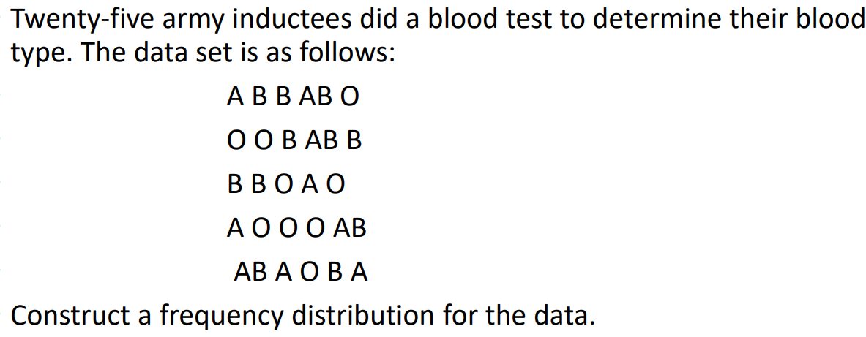
Example 1

Slide 30
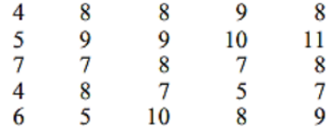
Ungrouped Frequency Distribution
When the data are numerical instead of categorical, the procedure for constructing a frequency distribution is somewhat more complicated.
Example 2
• A psychologist administered a test of manual dexterity to 25 third grade students. The times, in minutes, required to complete the test are below. Construct a frequency distribution for the data

Slide 31
Exercise
You are a health researcher analyzing the daily step count of individuals to understand their physical activity levels. Below is the raw data of the number of steps taken by 20 individuals on a particular day. Your task is to create an ungrouped frequency distribution table to summarize the data.
4300, 5600, 2300, 4900, 5800, 2300, 5200, 5600, 4800, 4600, 5300, 6700, 5700, 4300, 4400, 5900, 3000, 3900, 5000, 7100

Slide 32
Case Study 2:
Case Study 2: Data Analysis for Supply Chain Optimization
Background: A manufacturing company is experiencing challenges in its supply chain management, resulting in inefficiencies, increased costs, and delays in delivering products to customers. They have a wealth of data related to inventory levels, production schedules, transportation, and supplier performance. The company aims to leverage data analysis techniques to identify bottlenecks, optimize inventory management, and improve overall decision-making in the supply chain.
Objective: The objective is to utilize data analysis to identify areas of improvement within the supply chain, optimize inventory levels, streamline production schedules, and enhance decision-making processes to reduce costs and improve operational efficiency
• Explain the approach you will employ to achieve the objective
• What are the expected results?

Slide 33
Possible solutions
Develop predictive models to forecast demand, inventory levels, and production requirements.
Optimize production schedules and inventory management strategies based on the insights gained from the predictive models.
Perform exploratory data analysis to gain insights into the current state of the supply chain.
Identify trends, patterns, and correlations within the data using statistical techniques and data visualization tools.
Analyze key performance indicators (KPIs) such as inventory turnover, lead times, and on-time delivery rates to pinpoint areas of improvement.

Slide 34
Expected Results:
Improved inventory management: Reduction in excess inventory levels, minimized stockouts, and optimized reorder points leading to lower carrying costs.
Enhanced decision-making: Data-driven insights enable better decision-making regarding supplier selection, transportation routes, and production planning, leading to improved operational efficiency and cost savings.
Increased customer satisfaction: Faster order fulfillment, improved product availability, and fewer delivery delays resulting in higher customer satisfaction and loyalty.

Slide 35
Grouped Frequency
A grouped frequency distribution arranges data points into classes and counts how many points fall into each class.
It simplifies data analysis by showing the distribution of data points across different intervals.

Slide 36
Steps to Create a Grouped Frequency Distribution
Determine the Range: Subtract the smallest value from the largest value in the dataset.
Choose the Number of Classes: Typically, 5 to 20 classes are used. The choice depends on the size of the data and the level of detail desired.
Calculate Class Width: Divide the range by the number of classes (round up if necessary). The class width is the size of each interval.
Define Class Limits: Start with the smallest data point (or a convenient number slightly lower) and add the class width to define the limits of each interval.

Slide 37
Types of Frequency
Frequency (f): The number of data points in each class.
Cumulative Frequency: The sum of frequencies for all classes up to and including the current one.
Relative Frequency: The frequency of a class divided by the total number of data points.

Slide 38
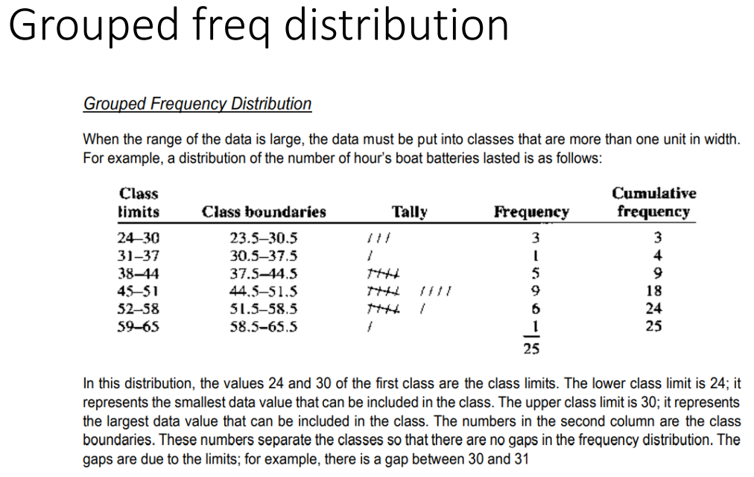

Slide 39
Terms
Class width refers to the difference between the upper and lower boundaries of any class
class boundaries are individual values chosen to separate classes (often being the midpoints between upper and lower class limits of adjacent classes)
Grouped data means the data (or information) given in the form of class intervals such as 0-20, 20-40 and so on. Ungrouped data is defined as the data given as individual points (i.e. values or numbers) such as 15, 63, 34, 20, 25, and so on.
Sometimes it is better to use a grouped frequency table that displays the frequencies for an interval rather than a specific value.
A grouped frequency table is a better choice than a frequency table when the data are composed of continuous interval variables, cover a huge range, or are very large

Slide 40
Rules to construct class distribution
1- There should be between 5 and 20 classes. Though this can depend on the size of the data. A student would not be in error for having less than 5 classes or more than 20 classes; however, statisticians generally agree on these numbers.
2- The class width should be an odd number. This ensures that the midpoint of each class has the same place value as the data. The class midpoint X is obtained by adding the lower and upper boundaries and dividing by 2, or adding the lower and upper limits and dividing by 2
3- The classes must be mutually exclusive. Mutually exclusive classes have non-overlapping class limits so that data cannot be placed into two classes

Slide 41
Rules to construct class distribution
4- The classes must be continuous. Even if there are no values in a class, the class must be included in the frequency distribution. There should be no gaps in a frequency distribution. The only exception occurs when the class with a zero frequency is the first or last class. A class with a zero frequency at either end can be omitted without affecting the distribution.
• 5- The classes must be exhaustive. There should be enough classes to accommodate all the data
• 6- The classes must be equal in width. This avoids a distorted view of the data.

Slide 42
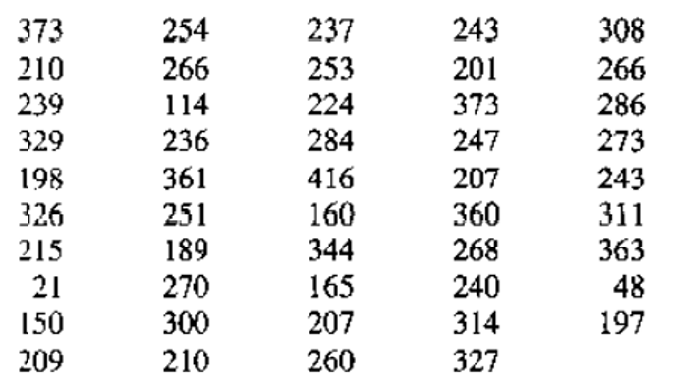
Exercise
The numbers of games won by the pitchers who were inducted into the Baseball Hall of Fame through 1992 are shown below. Construct a frequency distribution for the data using 12 classes

Slide 43
Exercise 2
Given the heights (in cm) of 40 people: [162, 158, 177, 185, 163, 172, 174, 168, 171, 154, 169, 180, 165, 176, 178, 182, 187, 173, 175, 170, 166, 167, 183, 181, 186, 159, 160, 164, 155, 156, 157, 179, 184, 188, 189, 190, 191, 192, 193, 194].
Determine an appropriate number of classes, calculate class width, and create the grouped frequency distribution.

